Slide 1
How Families are Integrated to Assist in the Recovery of the Participants
BY: Honorable Robert S. Anchondo

Slide 2
Family Unit
The family is the foundation of support, even if we have to hear the hard truth. They comfort us and even put us in our place. It builds up a person’s character and personality.

Slide 3
Readiness to change
Are there adequate resources to make a lasting change
(support/peer groups, counseling and life coaching services)
Barriers
Getting to know the family dynamic establishes a foundation for treatment and services
Relapse
learning the history of the home prepares the team when relapse occurs

Slide 4
Target Population
Eligibility Criteria
High Risk / High Need
Two or more DWI
Non-Compliant with regular probation conditions (failed breath analysis, new dwi arrests, unwilling to arrive to scheduled appointments)

Slide 5
New Participant
Breaking down the dynamics
What do we need to know about this participant
Social Status
What is the employment status
What recreational habits are potential triggers
Family
Does the family support recovery
How will the home environment impact the program

Slide 6
Agency, Organization, and Community Partnerships
Partnerships are an essential component of the DWI court model.
They enhance credibility, bolster support, and broaden available resources.
With the cooperation of other agencies, as well as community organizations the court has formed a partnership in support of the goals of the DWI program.

Slide 7
Community Partners
One of our community partners is a for profit organization that assists this program to provide the following:
Providing services to the individual-mental health
Services to the family
Couples/Marriage counseling

Slide 8
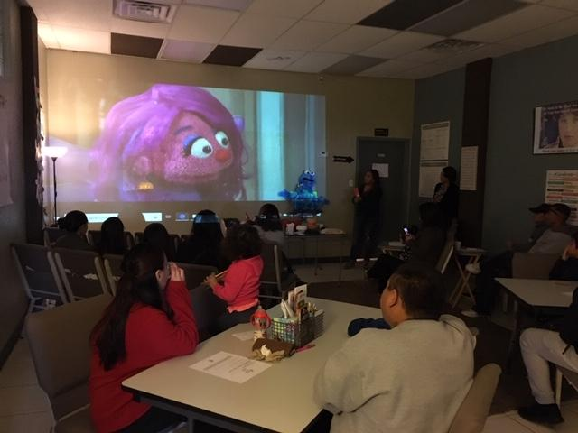
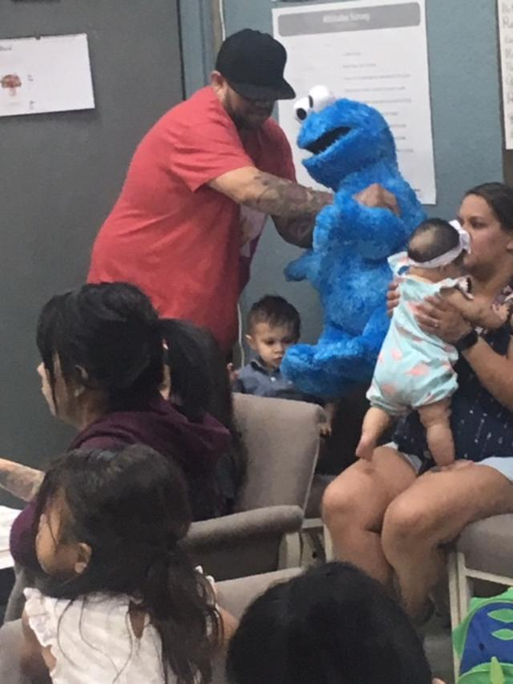
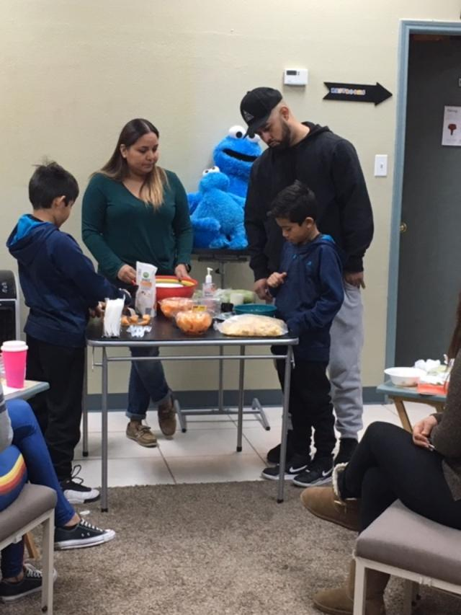
Educating life skills through playful activities to motivate and empower participants
Sesame Street- working with children and parents using video and activity, team building, cooking (one hour)

Slide 9
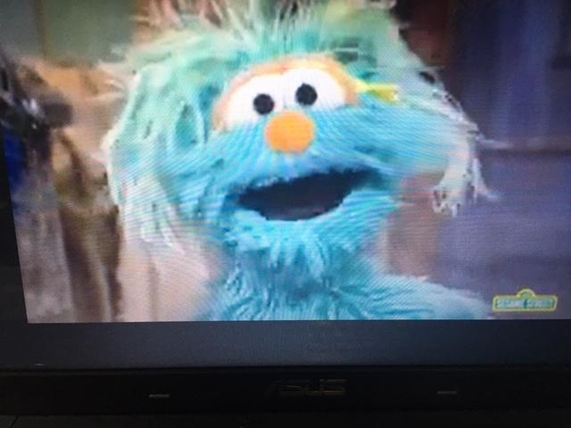
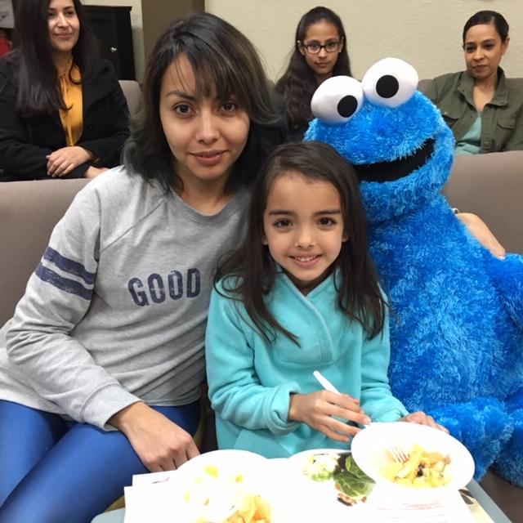
Our Sesame Mission
Serving families by
Educating life
Skills through playful
Activities to
Motivate and
Empower

Slide 10
Staffing
Weekly staffing is where the entire team has the opportunity to discuss the family dynamic.
Public Defenders, District Attorney’s Office, Law Enforcement, Probation, Counseling services and treatment all meet with the Judge to breakdown the weekly encounters with the participant.

Slide 11
Staffing
Compliance officers
give detailed reports on:
the environment and behaviors from family members or the participant that raise concerns.
Counseling services and treatment:
bring forth information necessary to raise concerns to team, to notice potential relapses, or to praise progress

Slide 12
Develop Case Management Strategies
There are five core functions of case management in a DWI court setting: 1) assessment; 2) planning; 3) linking; 4) monitoring; and 5) advocacy.
Family members are also included in the case management process, they are referred to outside agencies for help.

Slide 13
Address Transportation Issues
Transportation/Support
Is family/friends willing to assist with transportation to get to appointments/work?
Addressed during family meeting with the team, informed if participant is not allowed to drive, and as needed during the program.

Slide 14


Compliance
We partner with the El Paso County Sheriff’s Office and the El Paso Police Department. The officers assigned to the court assist with the following:
Home visits
Conditions of the home are recorded, drug and alcohol tests are administered, interview with persons living in the home are conducted.
Employment verification
Surveillance
Monitor criminal activity

Slide 15
Take a Judicial Leadership Role
Judge speaks to the participant’s family members and explains the importance of their role in the participants recovery.
He explains the importance of having their support and contact with the DWI team.
The success or failure of a DWI court in large part depends on the convictions held and strength exuded by the judge as leader of the program.

Slide 16

Questions?

