Slide 1
Military Cultural Competency
2 Hr. Workshop
Veterans Behavioral Health, MHA of Greater Houston

Slide 2
The Moral Obligation to Know our Veterans

Slide 3
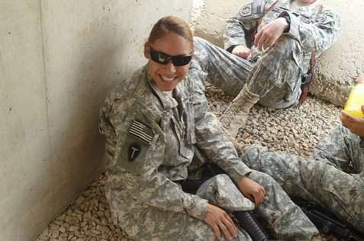

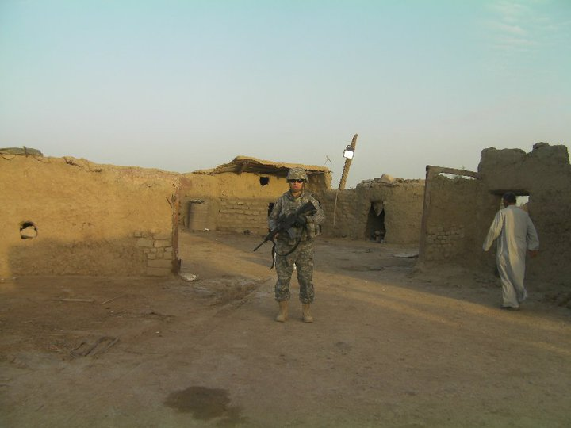


Meet your Instructor:
T’Liza Kiel
Mental Health America of Greater Houston, Veterans Behavioral Health Director
Army National Guard, Veteran
OIF 2009-2010
B.S, Criminal Justice
M.A., Sociology

Slide 4
Class Introductions
Name
Military Affiliation if any:
  Are you a veteran?
  Are any of your family members Veterans?
Why is this workshop important to you?

Slide 5
Workshop Objectives
1. Provide a clear and general understanding of Military Culture
  Describe how military culture may contribute to stigma, help seeking, and health behaviors
  Identify factors that shape opinions about the military and military service
  Evaluate the possible impact of military culture and Service Member, Veterans or Family sense of self, others and worldview
2. Train staff about military-related trauma and the impacts trauma may have.
3. Analyze potential prejudices and biases that you may hold related to military culture, Service Members, and/or Veterans
4. Understand best practices in working with Service Members, their families, and Veterans, in any settings
5. Increase knowledge of resources

Slide 6
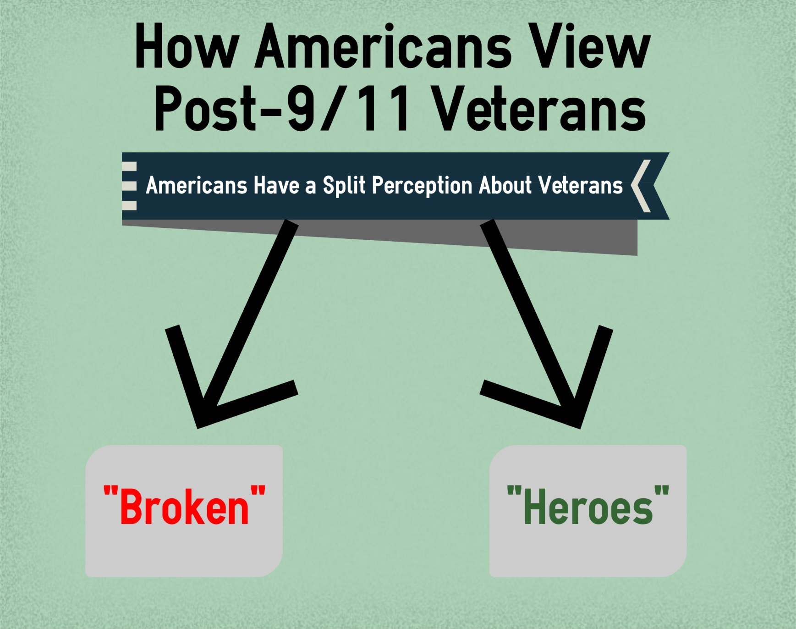
This belief is not deeply rooted and can be changed.
Notes:
There is a split perception in our nation about how they view returned veterans. Many people view returned veterans as “broken” or “damaged.” This is often based on media portrayals of veterans suffering significant mental health issues (such as severe post-traumatic stress disorder) and news reports of shootings, suicides, and family violence. Another faction in America views our returned veterans as “heroes” based on those wanting to acknowledge the service and sacrifice of the U.S. military post-9/11. Sometimes this is out of a desire to atone for the treatment of Vietnam veterans, sometimes it is out of genuine respect and honor. Whatever motivates individuals to feel one way or the other; this impacts how our nation’s veterans are viewed and treated.

Slide 7
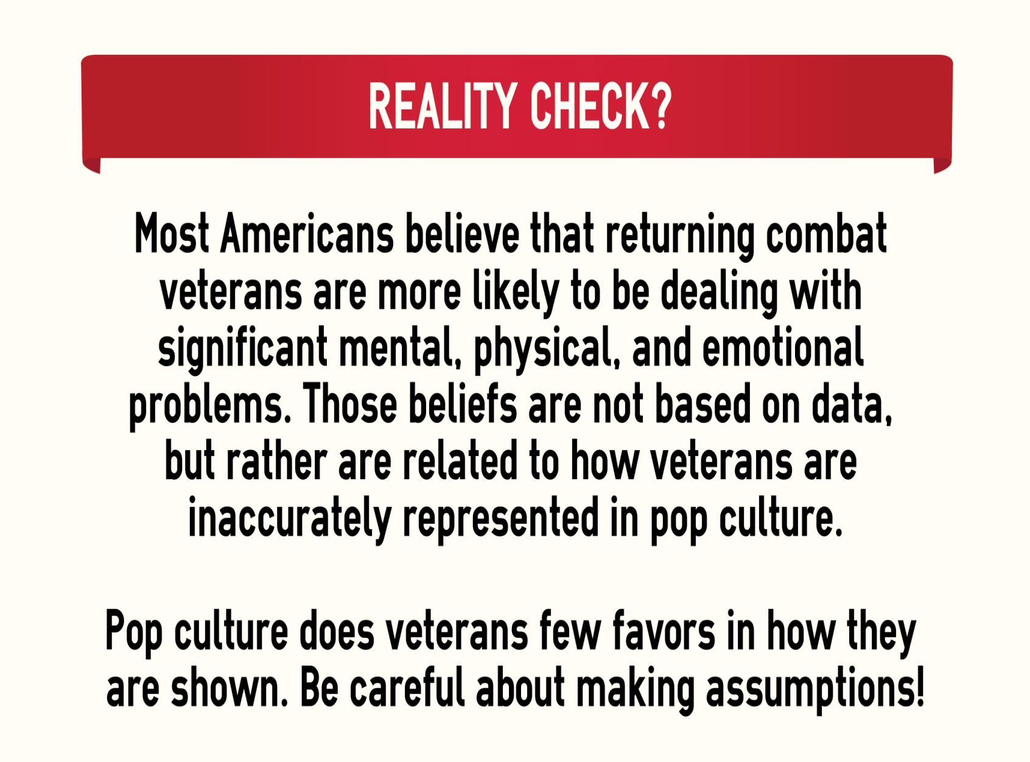
Notes:
Do we, as a culture, fear veterans? Is it because we know so few of them and so little about them?
What do you think is the root of this false belief?

Slide 8
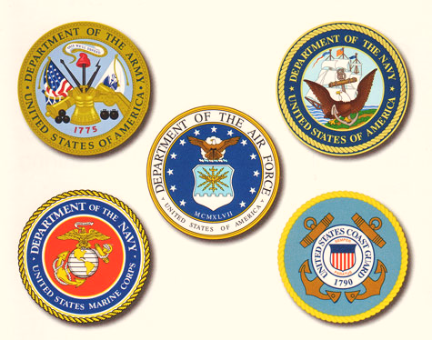
The Military Branches
Notes:
There are five branches of the US Military: The US Army, the US Navy, the US Air Force, the US Marine Corps, and the US Coast Guard.
The Department of Defense has oversight of the Army, Marine Corps, Navy, and Air Force. The Department of Homeland Security has oversight of the Coast Guard.
Each of these branches has a specific mission:
Army – Land-based combat and command forces – an occupying force
Navy – Sea and Ocean-based combat and command forces – a water superiority force
Marine Corps – Amphibious-based land assault force of the Navy – an assault force
Air Force – Air-based combat and command forces – an air superiority force
Coast Guard – Inter-coastal and riverine patrol of the US and its interests – an interdiction force

Slide 9
The Military Family
There are five branches of the US military:
  Army
  Navy
  Marine Corps
  Air Force
  Coast Guard
Though they are separate branches with separate missions, structures, & customs, all service members (SMs) share a common respect and unity.
More information about the military as a whole can be found at http://www.defense.gov/About-DoD/insignias

Slide 10
Active/Reserve Components
ACTIVE COMPONENT
520,000 - Army
323,600 - Navy
190,200 - Marine Corps
327,600 - Air Force
40,000 - Coast Guard
RESERVE COMPONENT
205,000 - Army
59,100 - Navy
39,600 - Marine Corps
70,400 - Air Force
7,500 - Coast Guard
(http://www.dtic.mil/congressional_budget/pdfs/FY2015_pdfs/MILPER_CRPT-113hrpt446.pdf)
& (http://transportation.house.gov/uploadedfiles/coastguard2015.pdf)
Notes:
Each of the branches has an active component and a reserve component. The active component performs training and missions every day of the year. The reserve component of each force performs training 39 days of each year to be capable of performing missions. Both the active and reserve components have the exact same missions. Naturally, when called upon to perform missions, the reserve components require rigorous training which generally involves up to three months of direct training by their active component.

Slide 11

National Guard
The National Guard falls under the jurisdiction of the Texas Military Department.
They have two missions: State and Federal.
  This means they have two Commanders in Chief: the Governor and the President of the United States.
  Quite often, the National Guard represents the most deployed US force because of their dual-mission requirements.
Both Guard and Reserves train 39 days per year to be mission ready.
  This is a part time job. For example, a junior enlisted soldier makes roughly $250 per month.

Slide 12
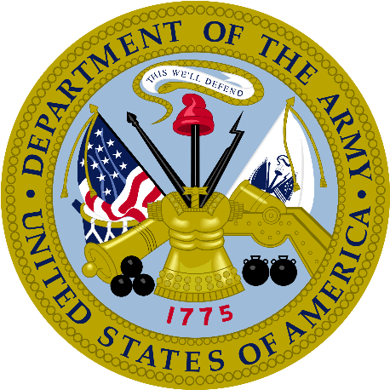
The Branches of the Military
Army
The U.S. Army’s mission is to fight and win our Nation’s wars by providing prompt, sustained land dominance across the full range of military operations and spectrum of conflict in support of combatant commanders.
People who serve in the Army are called Soldiers.
It is the largest and oldest branch of the military.
For information on ranks, traditions, organization, etc. please visit https://www.army.mil/features/#army101
Notes:
Army.mil

Slide 13

The Branches of the Military
Navy
The mission of the Navy is to maintain, train, and equip combat-ready Naval forces capable of winning wars, deterring aggression and maintaining freedom of the seas.
People who serve in the Navy are called Sailors.
The Navy is the second largest branch of the military.
For information on ranks, traditions, organization, etc. please visit http://www.navy.mil/navydata/organization/org-top.asp
Notes:
navy.mil

Slide 14

The Branches of the Military
Marine Corps
The mission of the Marines is to forward deploy to respond swiftly and aggressively in times of crisis; as soldiers of the sea, providing forces and detachments to naval ships and shore operations.
People who serve in the Marine Corps are called Marines.
The Marine Corps has been a component of the Navy since June 30, 1834.
For information on ranks, traditions, organization, etc. please visit http://www.marines.com/history-heritage
Notes:
Marines.mil

Slide 15

The Branches of the Military
Air Force
The mission of the Air Force is to fly, fight and win...in air, space, and cyberspace.
People who serve in the Air Force are called Airmen.
Originally part of the Army, the Air Force was formed as a separate branch of the military on September 18, 1947.
For information on ranks, traditions, organization, etc. please visit https://www.airforce.com/frequently-asked-questions
Notes:
Af.mil

Slide 16
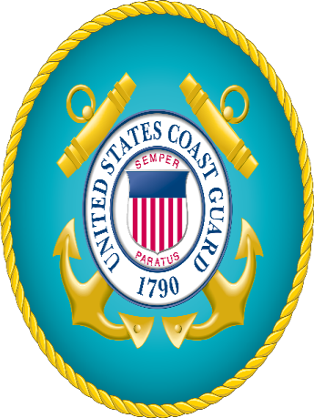
The Branches of the Military
Coast Guard
The mission of the Coast Guard is to safeguarded our Nation's maritime interests and environment around the world.
People who serve in the Coast Guard are called Coast Guardsmen.
It is the only military organization within the Department of Homeland Security rather than Department of Defense.
For information on ranks, traditions, organization, etc. please visit http://www.uscg.mil/history/faqs/faqs.asp
Notes:
usgc.mil

Slide 17
All military branches have active, as well as reserve components.
Authorized Active Duty
Authorized Reserve Components
Army – 483,500
Navy – 327,900
Marine Corps – 186,000
Air Force – 325,100
Coast Guard – 40,000
Army Guard – 343,500
Army Reserves – 199,500
Navy Reserves – 59,000
Air Guard – 106,600
Air Reserves – 69,800
Marine Corps – 38,500
Coast Guard Reserves – 7,000
*Army and Air Force have both Reserves and National Guard.
Notes:
https://budget.dtic.mil/pdfs/FY2018_pdfs/AUTH/MILPERS_Auth_2018_115-S2810.pdf
https://transportation.house.gov/uploadedfiles/cg_2017_packet.pdf

Slide 18
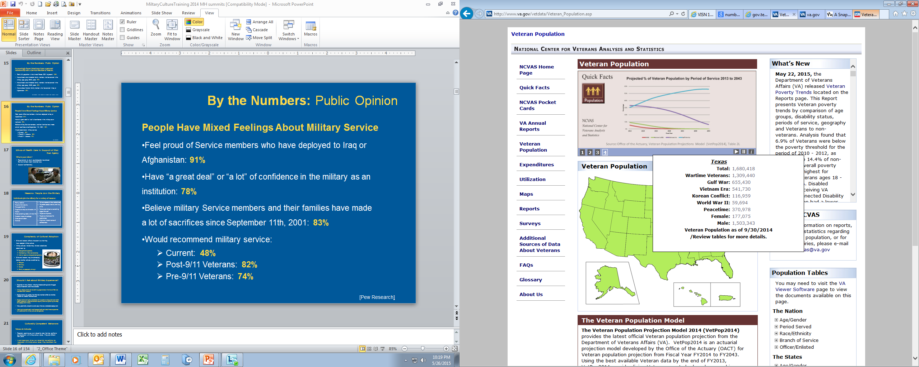
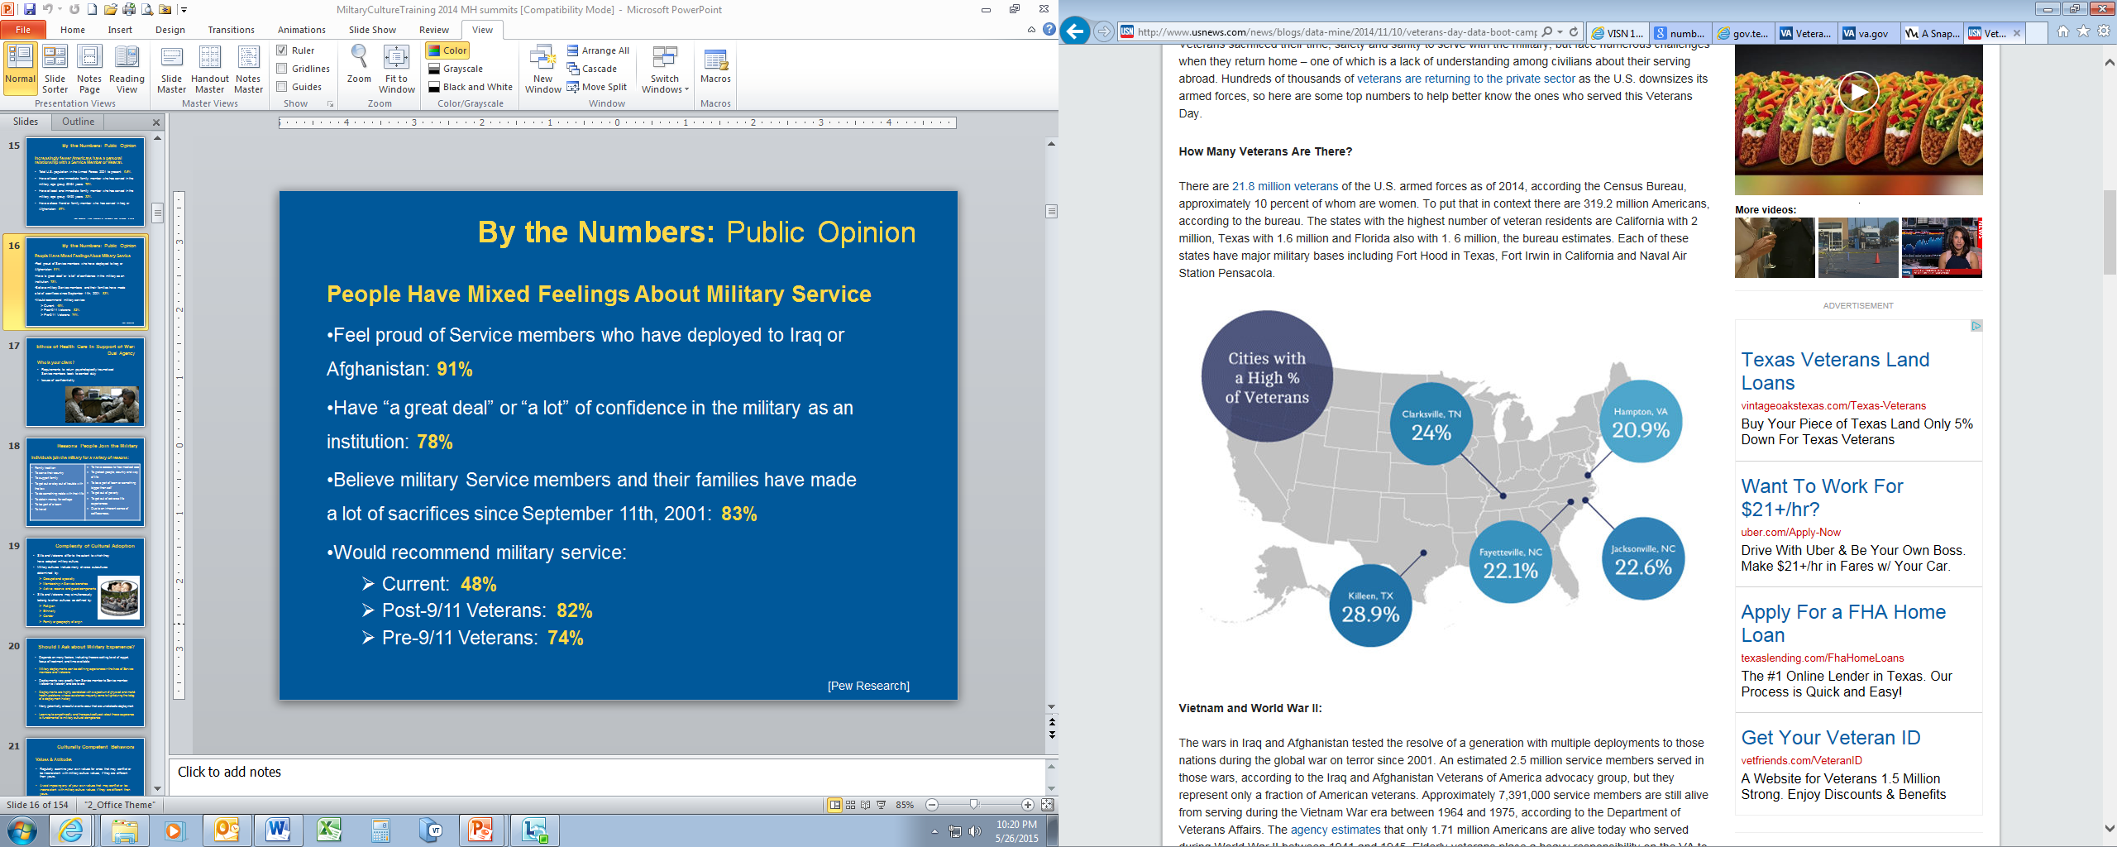
Veterans & Military in Texas
Ranks 2nd in U.S. in number of Veterans
  Approximately 1.6 million
  Est. family members 2.6 million
  Total is approx. 18% of the states population
Notes:
Only California has more veterans than Texas. California has approximately 2 million veteran residents. However, as we continue to see, the number of people moving to Texas as a result of the economy and job opportunities continues to grow which, in turn, also means the number of veterans will continue to grow.

Slide 19
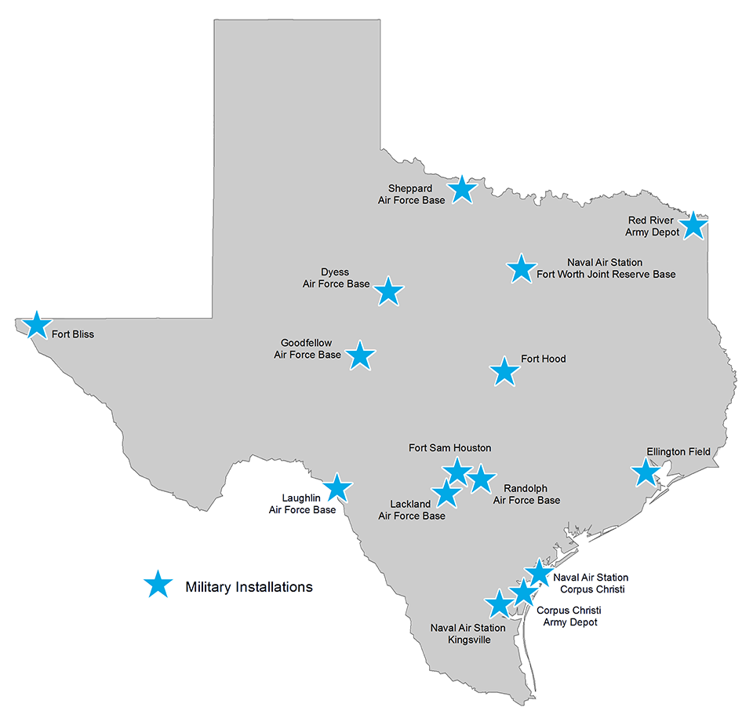
Military Installations in Texas
15 Total Installations
6 Air Force
5 Army
2 Navy
2 Joint Reserves
Various Reserves and National Guard Units are located throughout the state.
Notes:
It is natural that these locations also have a very high veteran resident population because of the access to military installation facilities such as hospitals, commissaries, and exchange retail stores.

Slide 20
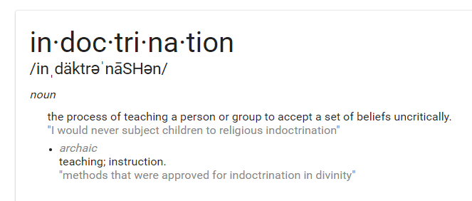
The Process

Slide 21
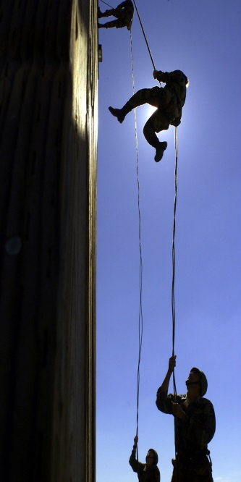
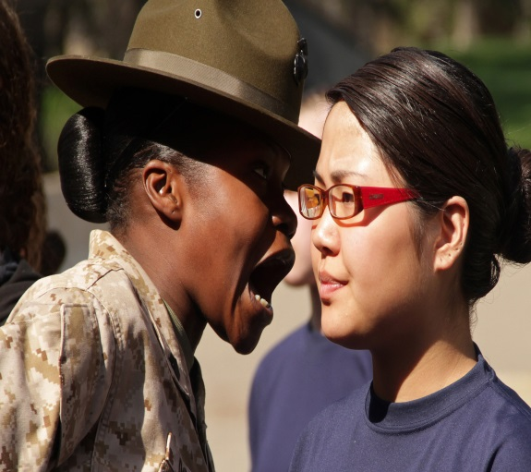
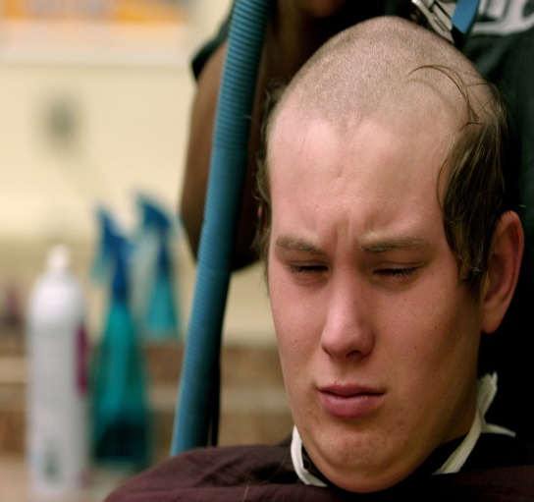
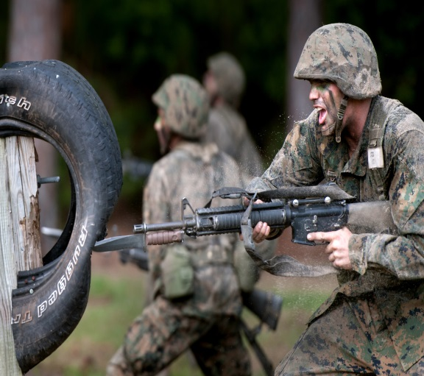
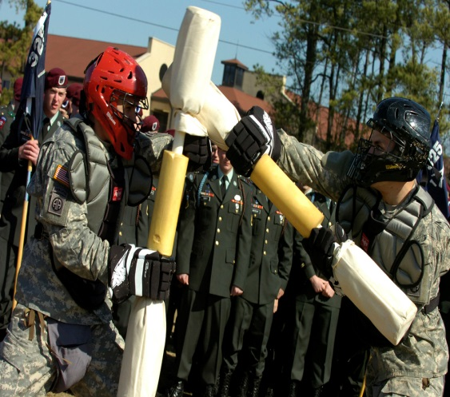
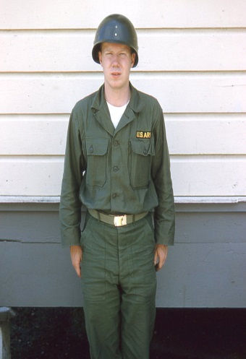
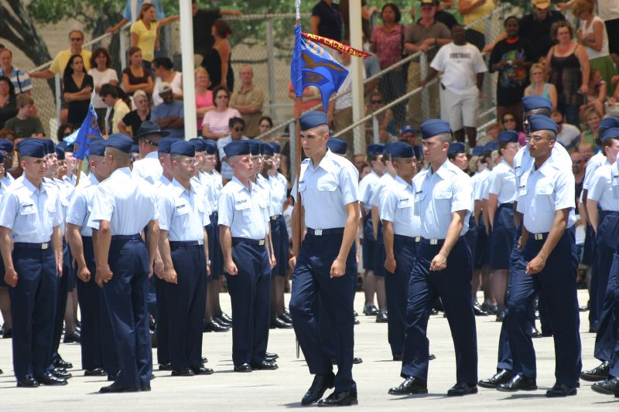
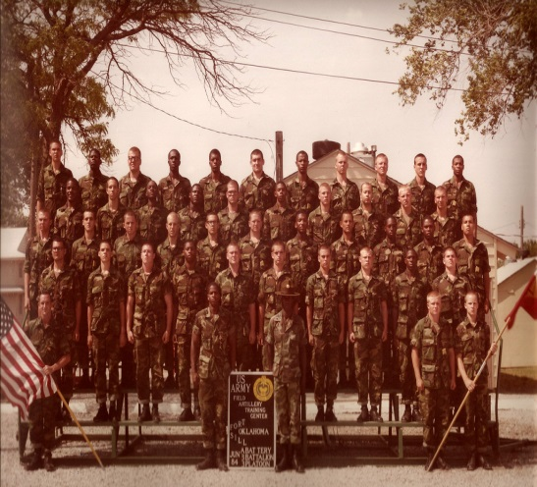
Forging the Warrior
from the Civilian
Notes:
Basic or Initial Training: 8 to 12 Week Process
Initial indoctrination training
Well-refined process of stripping away individuality and civilian mind-set and replacing them with mission and team focus based upon steeped military culture
Physically demanding
Every service member goes through this training
Instills the basics of fighting, closing with, and killing the enemy while also learning how to survive as a member of a team

Slide 22
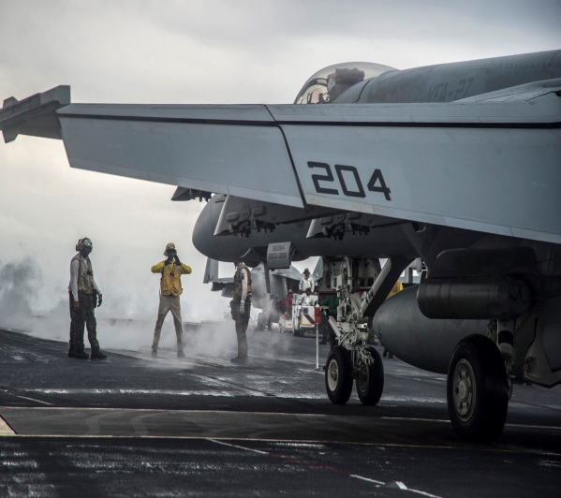
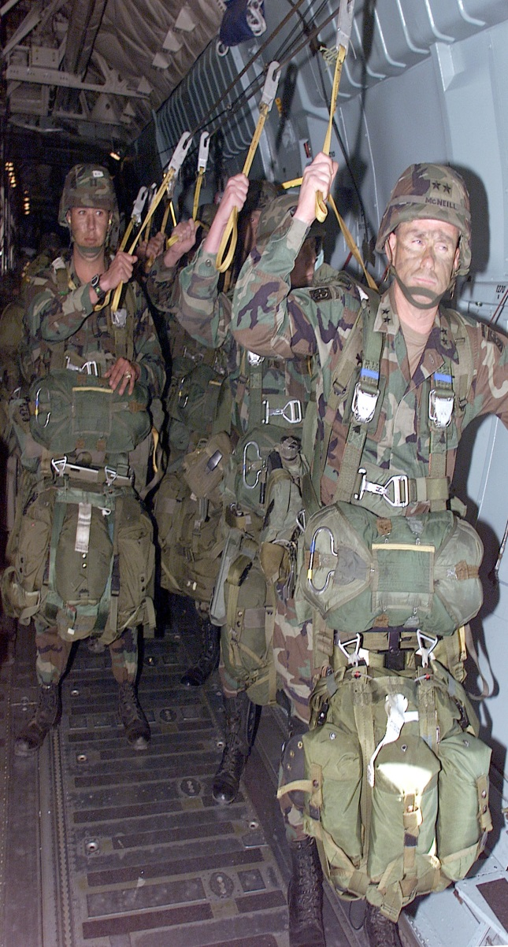
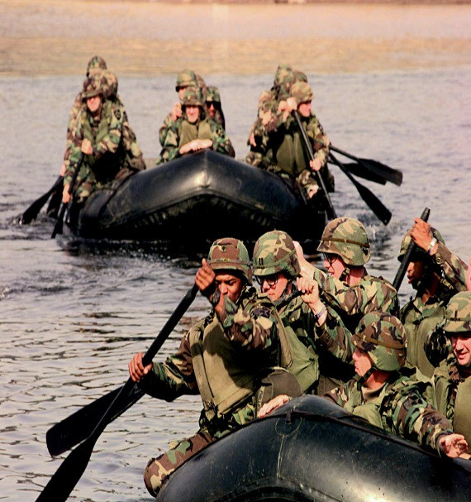
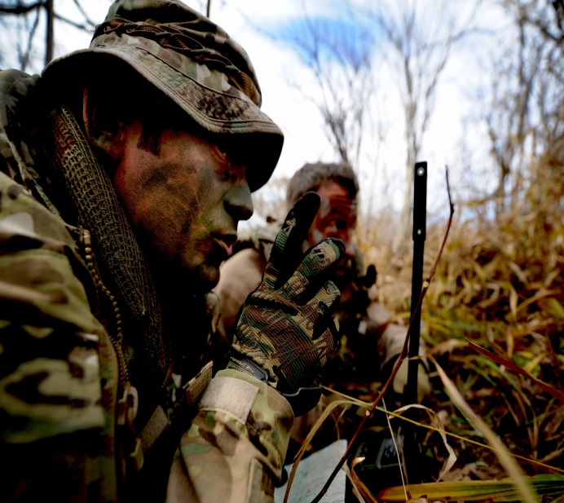

Continuous Training
Notes:
Post-Initial Training – this training is constant and non-stop. It will continue for the duration of a veteran’s career (a couple years or up to and beyond 20 years of service). This includes Advanced Individual and Unit Training.
Individuals receive advanced job-related skills and integrate into their units at duty stations across the world
Training continues in these units which culminates in combined arms exercises (multiple forces and military disciplines) and with live-fire operations.
Joint operations training centers across the US replicate the battlefield of today’s conflict-area landscapes
Training is extremely intense and creates the best prepared military in the world.
The US military publicizes its training as a deterrent to armed conflict.
Training ends with declaration of readiness and preparations for combat

Slide 23
Preparing for Combat
Back to back deployments are common since 9/11. This can happen due to:
  Leaving a unit that just deployed and joining one that is about to.
  Getting attached to other units while yours is home.
  Volunteering to go again.
While the rate of unit activity, or Operational Tempo, of deployments has actually increased, the number of personnel who are required to participate them has only come from the All Volunteer Force.
  Viet Nam was the last major combat operation that included conscripted US Servicemen.
Click for video of live fire training

Slide 24
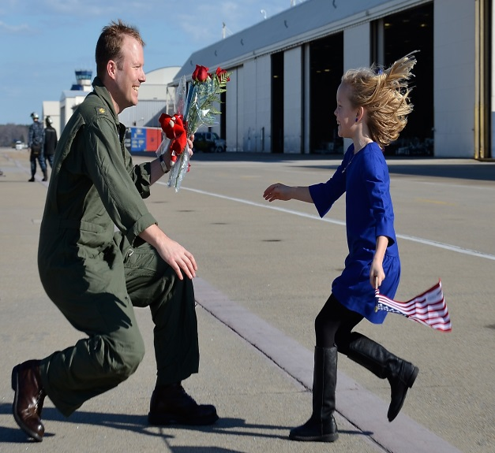
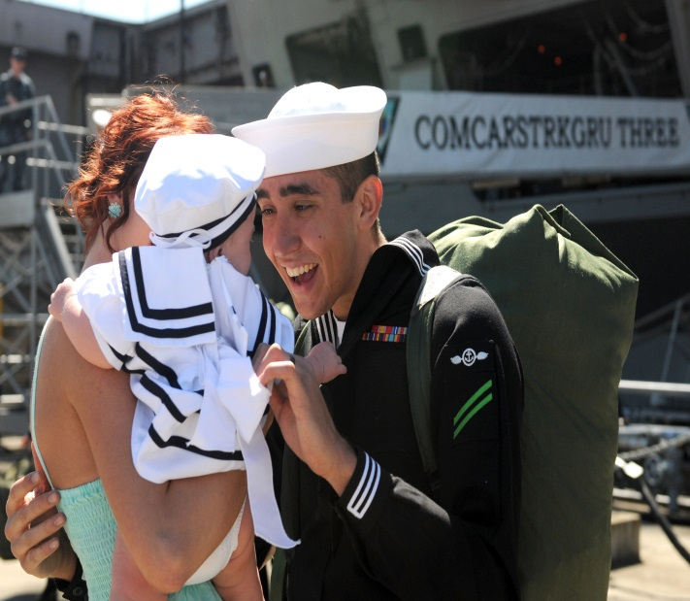
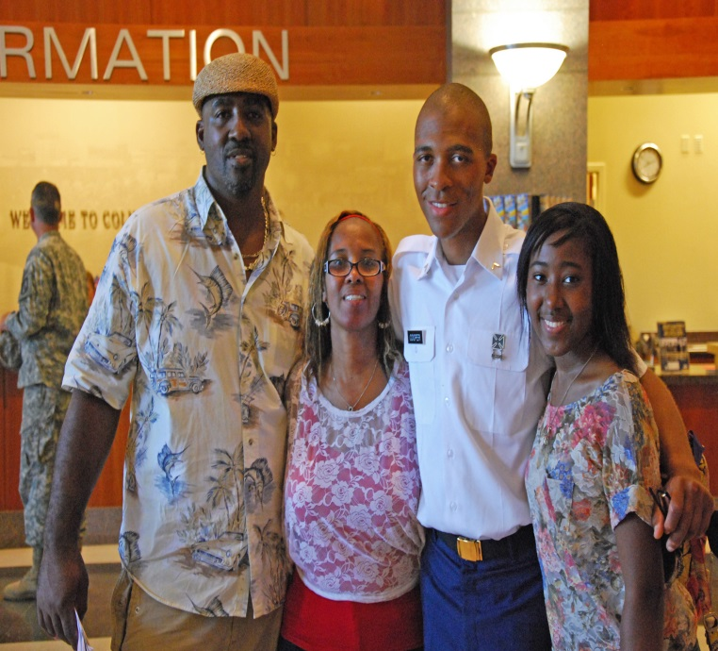
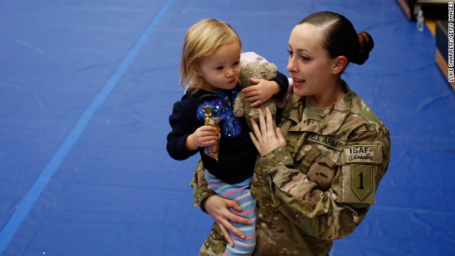
What about Families?
Notes:
Families
Serve and share the same joys and sorrows of military life as the service member.
Form very tight bonds within the military community.
Communities and school with few service members or veterans may have reduced knowledge or empathy for military families
Kids acting our may be labeled troubled kids when they are reacting to parent(s) combat experience.
Silent suffering is common among military families in civilian communities
Service Members returning from war may have emotional detachment.
May have seen their military family (unit) in danger, wounded, or killed
May have little empathy or understanding for civilian priorities
Family and soldier will need to forge new bonds and create new communication
TBI, PTSD and MST may adversely affect family reunification

Slide 25

Below the Surface
Notes:
Military Culture Iceberg - Center For Deployment Psychology
https://www.youtube.com/watch?v=LBF6BCV1wlc

Slide 26
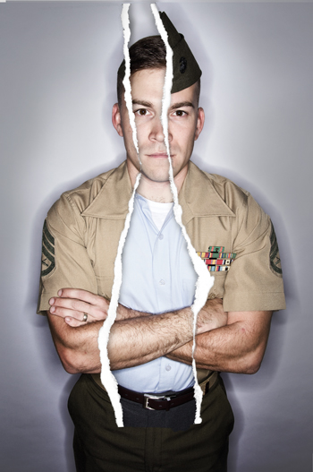
Transition is a 60-90 day process…Or is it?
Notes:
By federal law a Veteran is entitled to 365 days of transition services before leaving active military service
Per mission requirements, you may get 90 days of transition preparation
Training is excellent, covering:
Reintegration
Education
Employment services and
Family reunification
Veterans often don’t pay attention due to circumstances
The instructors often just left service as well, so do they not have real work experience to share
Transition planning is often started while during the deployment; there may be bombs going off or shooting happening while the training is going on, distracting the veteran. Veterans are often more focused on leaving, not on transition. The trainer is usually a person who just retired from active duty and may not have any more experience in the civilian world than the trainee

Slide 27
Hand-off to the
Veterans Administration?
…Not so easy
Notes:
VBA- Veterans Benefits Administration- Controls who gets what benefits, including healthcare.
VHA- Veterans Healthcare Administration- charged with taking care of the men and women who have gone to war.
Not all Veterans qualify for free services and some do not want VA healthcare. If someone receives a “Bad Conduct Discharge” or “Dishonorable” discharge listed on their DD-214, they will not be eligible for VA benefits.
All combat theater veterans discharged after 2003 are eligible for 5 years FREE healthcare from VA service providers
This allows time to process service connection claims and/or obtain alternate health coverage
Must have service-related condition or injury for lifetime free service (limited to service-connected injury or disease).
Must have been awarded the benefit by the VBA, which can be a complicated claims process.
Healthcare assistance varies depending on the injury. Your healthcare can be just for a specific condition or injury, or for all your healthcare based upon your disability rating given by the VBA.
There are additional guidelines for veterans receiving VHA healthcare services, though are beyond the scope of this training. For more information refer to VA.gov resources or your local VHA facility.

Slide 28
Who Qualifies for VA Healthcare?
VBA- Veterans Benefits Administration- Controls who gets what benefits, including healthcare.
VHA- Veterans Healthcare Administration- charged with taking care of the men and women who have gone to war.
Not all Veterans qualify for free services and some do not want VA healthcare. If someone receives a “Bad Conduct Discharge” or “Dishonorable” discharge listed on their DD-214, they will not be eligible for VA benefits.
All combat theater veterans discharged after 2003 are eligible for 5 years FREE healthcare from VA service providers
    This allows time to process service connection claims and/or obtain alternate health coverage
  Must have service-related condition or injury for lifetime free service (limited to service-connected injury or disease).
    Must have been awarded the benefit by the VBA, which can be a complicated claims process.
  Healthcare assistance varies depending on the injury. Your healthcare can be just for a specific condition or injury, or for all your healthcare based upon your disability rating given by the VBA.
  There are additional guidelines for veterans receiving VHA healthcare services, though are beyond the scope of this training. For more information refer to VA.gov resources or your local VHA facility.

Slide 29
Service Member Life Cycle: an example
At 22 years of age, the average military service member has relocated from home more than once, has family and friends often residing in at least 2 other states, has traveled the world, through peacekeeping or wartime missions/deployments, been promoted 3 times, bought a car and wrecked it, married and had children, has had relationship and financial problems, seen death, is responsible for dozens of soldiers, maintained millions of dollars’ worth of equipment, and gets paid less than $32,000 per year.
If this average service member enlisted directly after high school they have already completed their first enlistment contract.

Slide 30
Military Trauma

Slide 31
Physical Injuries are Common
The most common injury in veterans are the physical injuries
More and more veterans are surviving military injuries that would have killed them in previous wars:
  Amputations, polytrauma injuries (e.g. internal and external physical injuries. Ex: head trauma + amputation + broken bones + severe blood loss, though stabilized in theater and returned home)

Slide 32
What is ‘Traumatic in the Military’?
Potentially traumatic events include those that involve actual or threatened death, serious injury, or sexual violence.
Everyone’s experience while deployed to a war zone, whether on a front-line or support role, is unique and the same event may or may not be perceived as traumatic by different people.
Most traumatic stress reactions are “normal responses to abnormal events” and only become symptoms of a disorder when they persist and cause significant distress or impairment in life functioning.

Slide 33
Veterans live with multiple unseen injuries:
Post Traumatic Stress Symptoms or Disorder
Traumatic Brain Injury
Military Sexual Trauma (MST)
  ~40% personal trauma (e.g. rape)
  ~85% incl. sexual harassment, witnessing or experiencing
Moral Injury
  Acts that go against the way we were raised or against our belief systems (e.g. killing children)
Depression
Comorbidity
Notes:
Stress the importance of identifying that these are all injuries related to military service and are not illnesses a person is born with.
Unlike mental illness, these did not manifest on their own. Most of these are a direct result due to their service in the armed forces.

Slide 34
Protective Factors
As with anyone, there are dynamics that influence the severity of the impact of trauma on veterans. Some factors that increase resiliency are:
Biological vulnerabilities
Pre-trauma life experiences
Age at the time of trauma
Frequency and severity of traumatic stressors
Environmental support after trauma

Slide 35
A Few Acronyms to know
PCS – Permanent Change of Station
ETS – Expiration Term of Service
DD214 – Discharge paperwork
MRE – Meal Ready to Eat
NCOIC – Non Commissioned Officer in Charge
Garrison – Home Base
FOB – Forward Operating Base
AGR – Active Guard and Reserve
DoD – Department of Defense
CAC – Common Access Card
NES – Navy Enlisted Classification
ROE – Rules of Engagement
http://www.dtic.mil/doctrine/new_pubs/dictionary.pdf
Notes:
http://www.dtic.mil/doctrine/new_pubs/dictionary.pdf
it can quickly become a distraction and an annoyance if the client regularly has to stop to answer a counselor’s questions about the military, clarify a word or phrase, or address the confusion written across the counselor’s face.
It is also important to note that ‘military’ and ‘veteran’ should not be used interchangeably

Slide 36
VBH, MHA
Houston Chapter, Military Veteran Peer Network
  Milvetpeer.net
Veteran Peer Mentoring
Serving Justice Involved Veterans
Advocacy through Training and Education

Slide 37
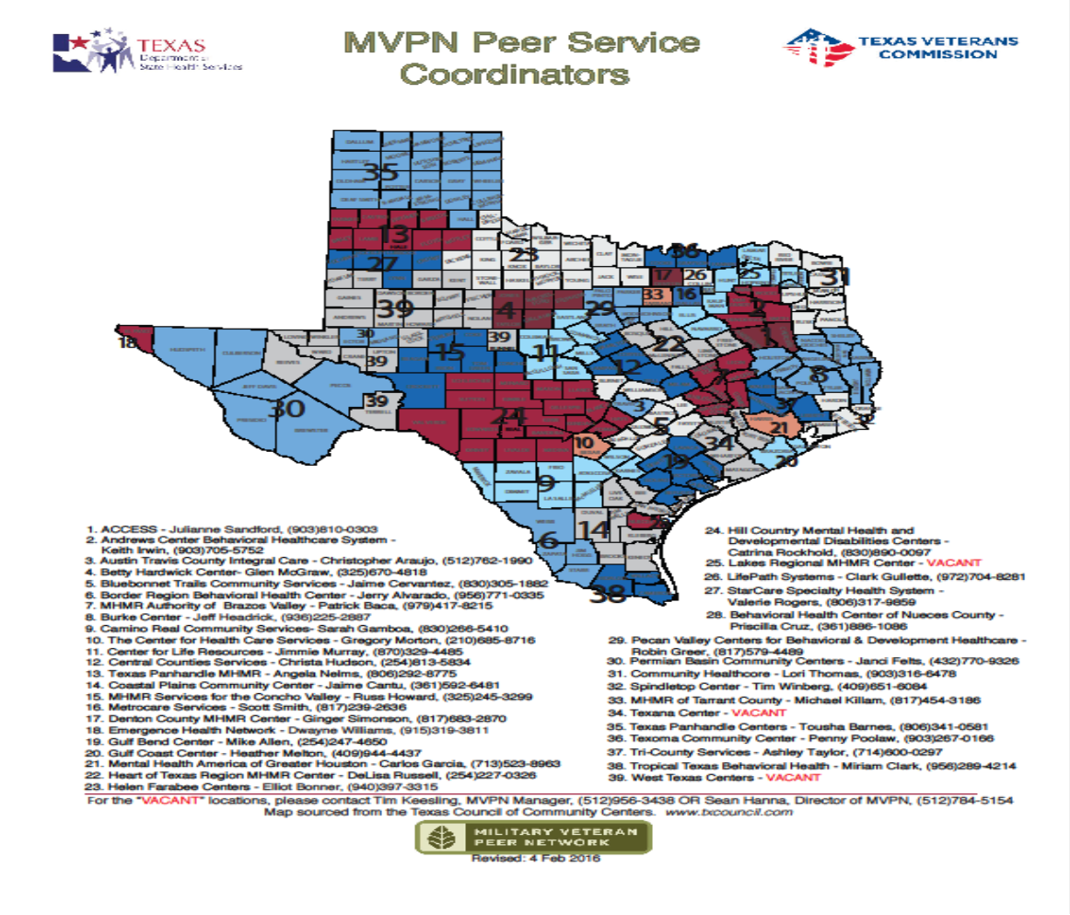
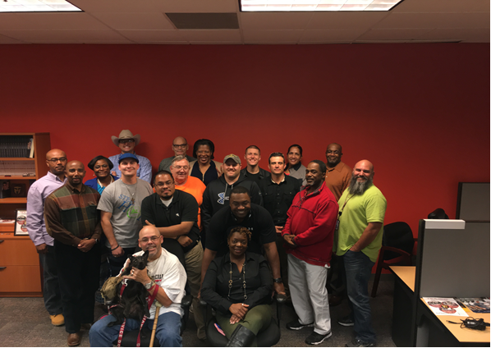
Empowering Arms

Slide 38
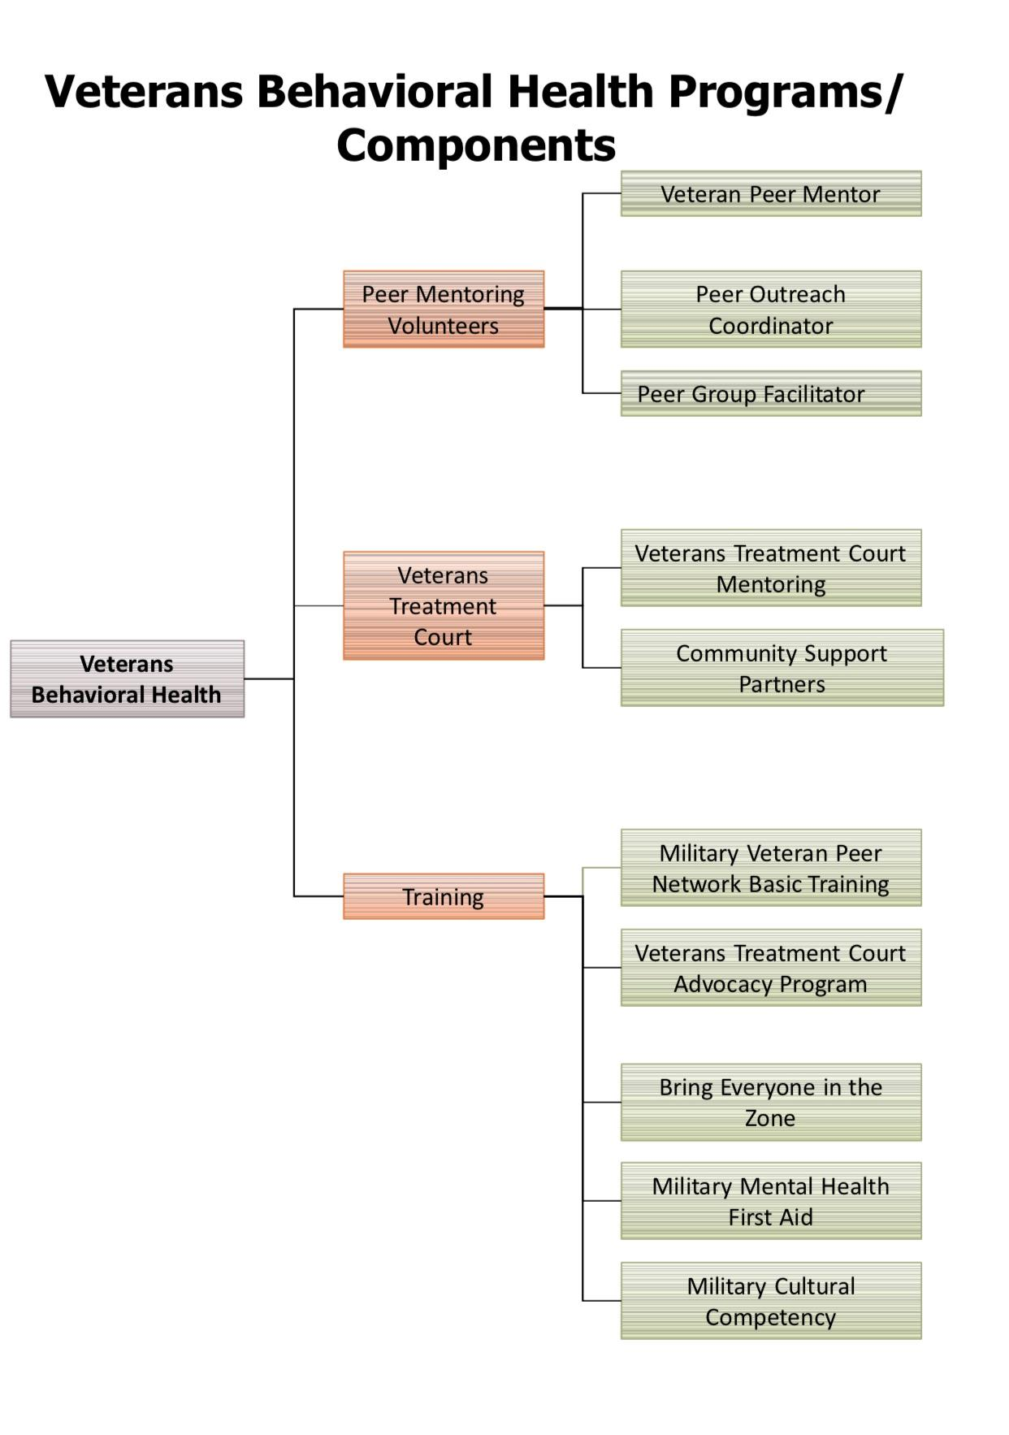
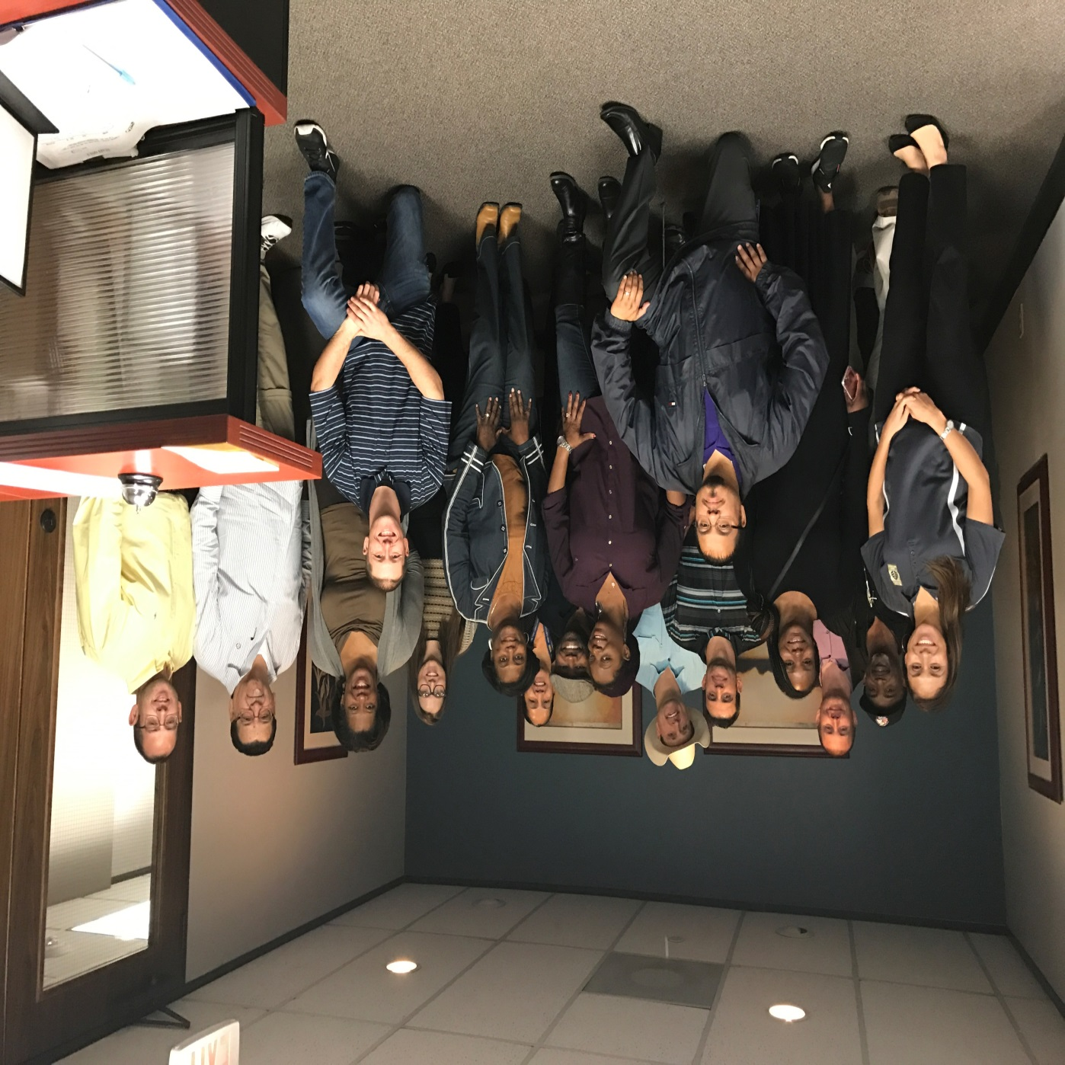

Slide 39
Houston Veteran Resources
Start Here
Veterans Behavioral Health Team, MHA of Greater Houston
  www.mhahouston.org
  https://mhahouston.org/veteran-resources/
United Way of GreaterHouston
  211
  Mission United
  https://www.unitedwayhouston.org/
  https://www.unitedwayhouston.org/our-work/mission-united
Combined Arms
  www.combinedarms.us

Slide 40
Questions?

