Slide 1


Key Moments in NADCP History
Signs That You Might Not be a Drug Court . . .
Douglas B. Marlowe, J.D., Ph.D.

Slide 2

Key Moments in NADCP History
Advisory*
*Points of view and opinions expressed in this presentation are solely those of the speaker, and do not necessarily represent the positions or policies of NADCP, NDCI, BJA, CSAT, NIDA, NIJ, any other federal acronym, or any polite or tactful person . . .

Slide 3
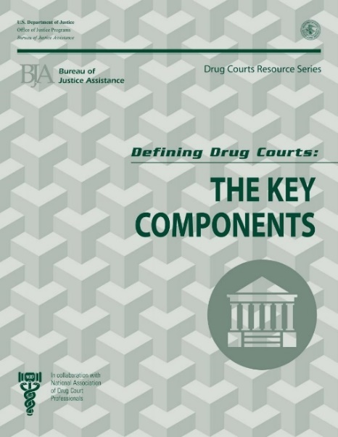
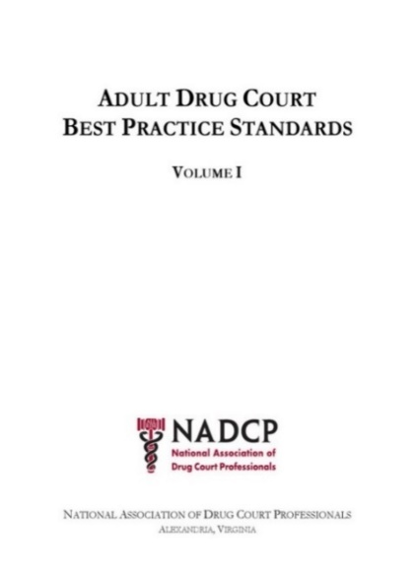
Defining Documents
Define what a drug court is
Not necessarily the only effective model
If you’re out of compliance, then you are not a drug court
Define what a good drug court is
Rooted in evidence of effectiveness
If you’re out of compliance, then you need training & technical assistance (TTA)

Slide 4
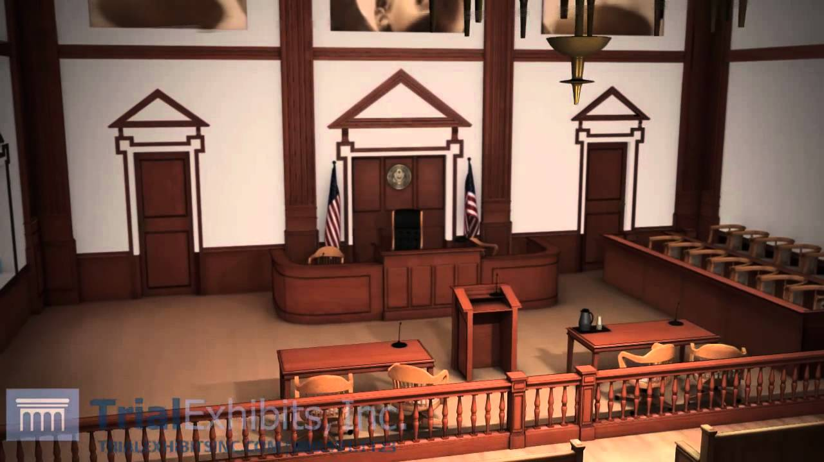
Key Moments in NADCP History
Drug Courts are Courts
Not simply diversion, deflection, decriminalization, medicalization, deinstitutionalization, restorative justice
Negotiated sentence or disposition
Public forum and public record
Ongoing judicial contact “is essential”
Due process (not arbitrary or capricious)
Right of appeal
Perception (and reality) of fairness
Courtroom as theatre (vicarious learning)

Slide 5


Key Moments in NADCP History
Treatment and Accountability
  Treat sick behavior, punish bad
  behavior, & reward good behavior
— and never confuse them! —
Gradually escalating sanctions for distal infractions, including substance use
Substantial sanctions, to include jail, for willful or proximal infractions
Jail as “detox”
Incremental rewards

Slide 6
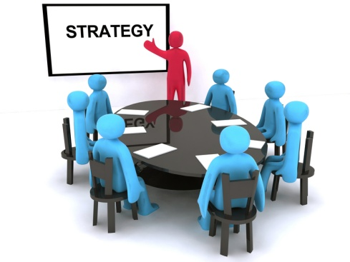
Key Moments in NADCP History
Multidisciplinary Team
Judge, prosecutor, defense counsel, treatment, probation, law enforcement, . . .
Defense counsel and prosecutor have their own Key Component!
Defense counsel waivers are generally revocable at-will unless already relied upon
Ongoing communication, information exchange, & shared decision-making
Involvement in coordinated responses to participant compliance
Team meetings and status hearings

Slide 7
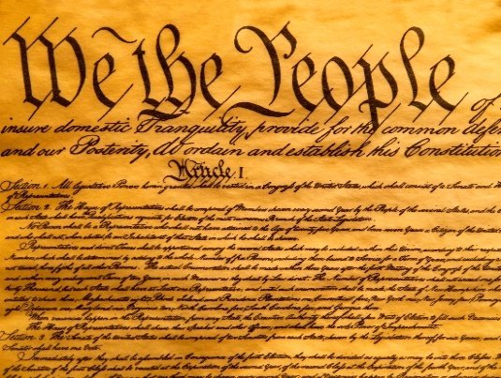
Key Moments in NADCP History
The Constitution Applies
Drug courts are courts of law
Procedural due process is relaxed but not abrogated (fair hearing commensurate with imperiled interests)
Substantive due process is unaffected
  Judges have discretion but it is not unbridled
  Rational basis test (at least)
  Particularized inquiry
  Reviewable record (articulated rationale)
Cannot require all future or contingent rights to be waived irrevocably
Equal protection applies (suspect classes)

Slide 8

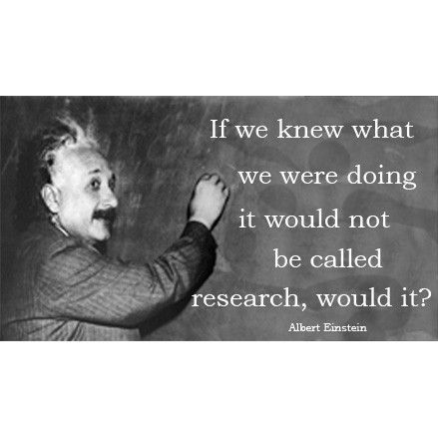
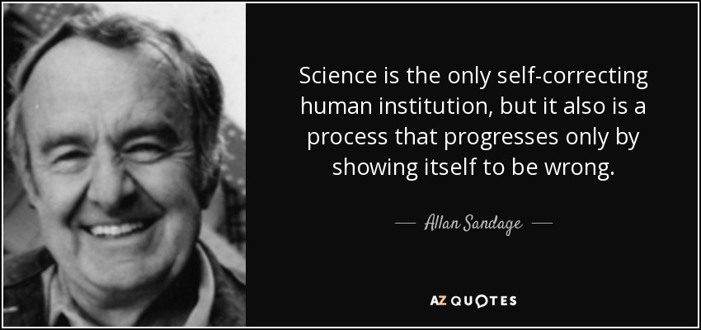
Key Moments in NADCP History
Self-Learning & Correcting
Two Key Components (20%) are dedicated to ongoing program evaluation and continuing professional education
Innovative, not sclerotic
Establish effectiveness and
engage in continuous quality
improvement
Measuring performance and
outcomes is a substantive
element of the program

Slide 9
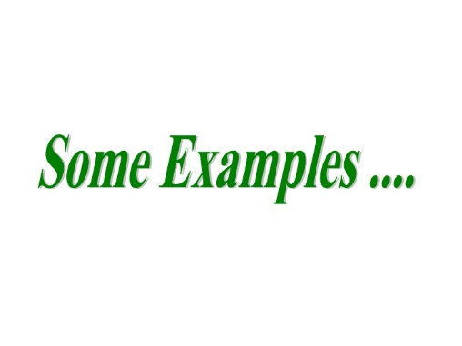
Key Moments in NADCP History
Questionable “Drug Courts”
Managed by community panel, treatment agency, probation, police, schools, prosecutor
Participant compliance reviewed individually or outside of courtroom
Jail sanctions imposed for substance use prior to clinical stabilization
Jail used as detox, treatment, or housing
Jail off the table for proximal infractions
No defense attorney or prosecutor on team
Participants must waive defense advocacy
Infrequent team meetings or presence
No hearing for jail or revocation

Slide 10
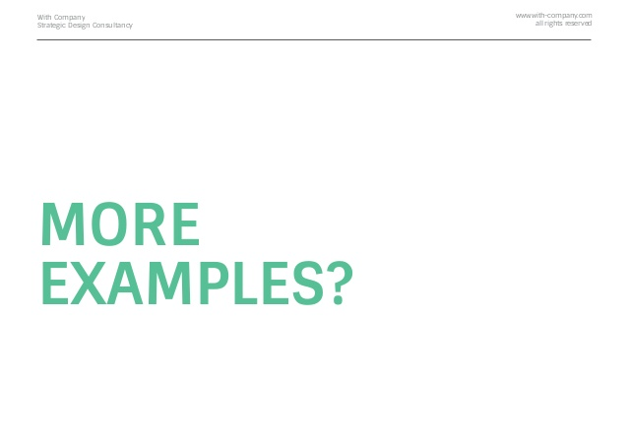
Key Moments in NADCP History
Questionable “Drug Courts”
continued . . .
Blanket prohibitions against evidence-based interventions (e.g., MAT)
Requirements not reasonably related to participant’s current offense, rehabilitation needs, or public safety threat
No current and reliable data on adherence to best practices, including access and outcomes for suspect classes
. . .

Slide 11
Key Moments in NADCP History
Quadrant Model
High Risk
Low Risk
High
Need
Can’t change
and
won’t change
Can’t change
Low
Need
Won’t change
Can change
and
will change

Slide 12
Key Moments in NADCP History
Quadrant Model
High Risk
Low Risk
High
Need
Require TTA &
accountability
Require TTA
Low
Need
Require accountability
Require time &
encouragement

