Slide 1
The Role of Peer Mentors in Veterans Treatment Courts
T’Liza Kiel, M.A.
Director, Veterans Behavioral Health
Mental Health of America

Slide 2
“As you grow older, you will discover that you have two hands — one for helping yourself, the other for helping others.” — Audrey Hepburn

Slide 3
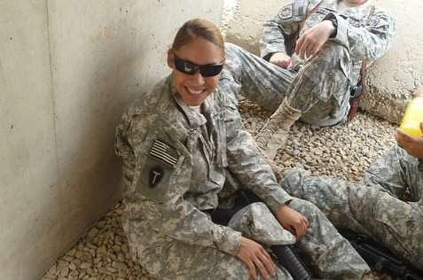
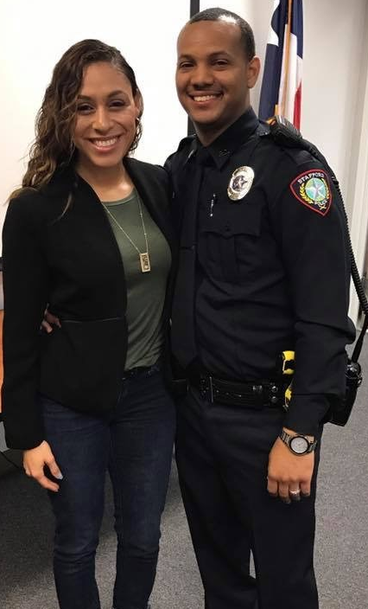
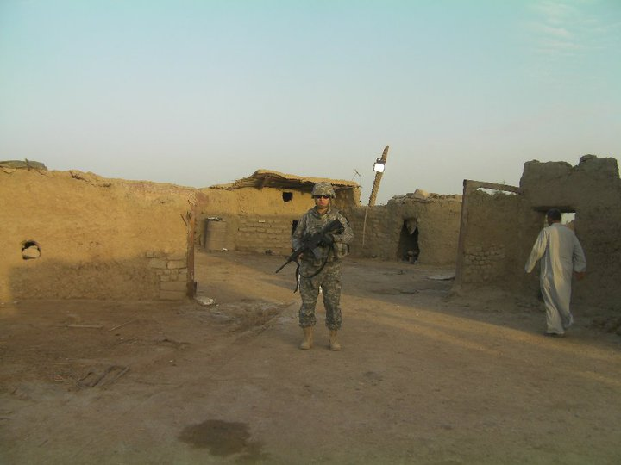
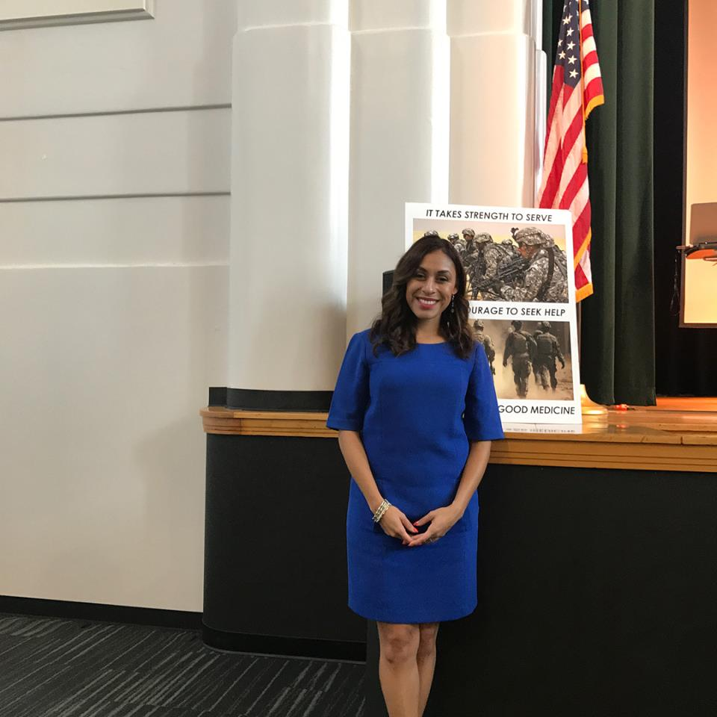
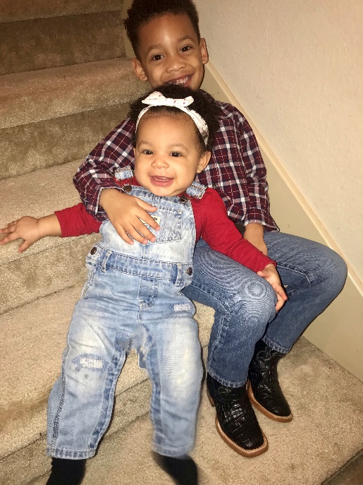
Meet your Presenter:
T’Liza Kiel
Mental Health America of Greater Houston, Veterans Behavioral Health Director
Army National Guard, Veteran
OIF 2009-2010
B.S, Criminal Justice
M.A., Sociology

Slide 4
Objectives
JIV Peer Support
What is a Peer Mentor
Role of Peer Mentor in Veterans Courts
Mission of Peer Program
Essential Elements of Peer Mentoring
Diversity in Court Mentorship Team
Role of the Mentor Coordinator
Models of Peer Mentorship in Texas –VCAMP/MHA and MVPN
Future Directions for Peer Mentors (Going Beyond the Court –Following Sequential Intercept Model)
Resources for Building/Sustaining Peer Mentorship Programming in Texas

Slide 5
Justice Involved Veteran Peer Support
Looks like:
Jail in-reach
Veterans Treatment Courts
Support Groups
One on one Support

Slide 6
Veterans Court Mentor
Acts as a resource and confidant to the Veteran
The Veteran Mentor acts as a coach, a guide, a role model, and an advocate for a veteran entered into the justice system. The mentor encourages and supports the veteran participant as he or she progresses through a court-mandated rehabilitative program.
Served or is serving in the U.S. Military
Is not a counselor

Slide 7
Importance of Mentors in VTC
Unique to Veterans Courts
Veteran to Veteran: Walked a Similar Path
Speak the Same Language
Facilitates Disclosure/Not a reporting agent
Serve as Role Models
Facilitate Crisis Resolution
Advocate and Promote Self-Accountability

Slide 8
Mission of the Mentor Program
Help our fellow Veterans receive the services they need to reach their full potential as productive members of society.
Help them navigate the court system, treatment system, and the VA system.
Assess their needs and help them adjust back to civilian life.

Slide 9
Duties and responsibilities as a Veteran Court Mentor
Attend Court as they can {Supportive}
Participate in and lead mentoring sessions {COMMUNICATION}
Be supportive and understanding of the difficulties the Veteran in court are facing {Empathy}
Assist the Veteran clients as much as possible within your boundaries and comfort level {Knowing the Resources}
Equipped and prepared for potential Crisis {Crisis Intervention}

Slide 10
Duties and Responsibilities cont’d
Be supportive and helpful to other Veteran Mentors
Communicate and stay close to the Peer Service Coordinator (if they have one), and essential court staff
Without question, if a veteran is showing signs harming self or others, court staff and necessary individuals are to be informed immediately.

Slide 11
Mentor Diversity
Demographics, Race, LGBT, Branch of Service, Education
When are you ready to be a mentor?
Graduates as Mentors- Pros and Cons
Military and Life Experience
Stigma of Combat vs Non Combat Relatability
Ratio of Mentor to Mentee

Slide 12
What to look for in a potential mentor
Knowledge & Experience, Branch of Service, Combat Experience, Age, Gender, Active duty/Reserve/National Guard
Criminal history
Temperament
Untreated Combat Mental Illness
Commitment to program
Willingness to be open
Effective communicator
Avoid Barracks Lawyers
Military Cultural Competency
The best Mentor qualities include:
Mindful Listener
Empathetic
Nurturing
Trustworthy
Observant
Respectful

Slide 13
Vetting the best VTC Peer Mentors
Local Peer Service Coordinator or Peer court Coordinator
www.milvetpeer.net
State JIV Coordinator, Erin McGAnn
Training your Peer Mentor Team
  MVPN Basic Training
  VCAMP
  Justice 4 Vets: Mentor Bootcamp

Slide 14
Mentor Coordinator Responsibilities
The Mentor Coordinator is the key to success of the program
Recruit volunteer Veteran mentors
Assist in their retention
Organize and conduct their training
Supervise the mentoring team and ensure equal balance of mentees
Sustain and evolve the Veteran Mentor Program
Maintain records and date of vet court interactions

Slide 15
Models of Peer Mentorship in Texas

Slide 16

MVPN Core Peer Mentor Training
Phase 1
Peer Support Fundamentals
Military Culture
Suicide Awareness
Peer Ethics
Support Opportunities
Phase 2
Depression Awareness
Addictive Behaviors
Stress Management
The MVPN SMART Tool

Slide 17


VCAMP
The purpose of this three-day training is to certify Veterans to be volunteer Veteran Court Mentors and provide each individual with the behavioral health education, innovative tools and technical assistance to develop their own local Mentoring Programs and increase capacity within an existing Veterans treatment court serving Justice- Involved Veterans. Trainings are provided in areas of suicide prevention and intervention, strategic planning, family resiliency, substance abuse, domestic violence awareness, resource coordination, mindfulness and more.

Slide 18



VCAMP
Family Resiliency Training
Personal and Community
Networking
Suicide Prevention
PTSD & TBI
Domestic Violence
Financial Habits
Family and Graduate Outreach
Social Work 101
Resource Coordination
Crisis Intervention
Professional Peer Support Coordination
Peer Support and Advocacy

Slide 19
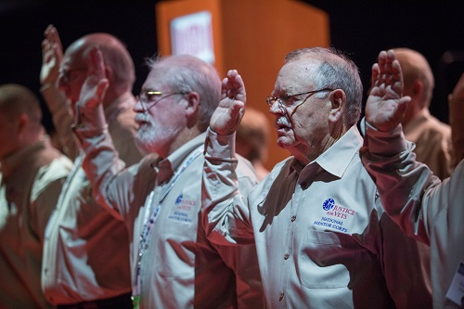


National Resources: Justiceforvets.org

Slide 20
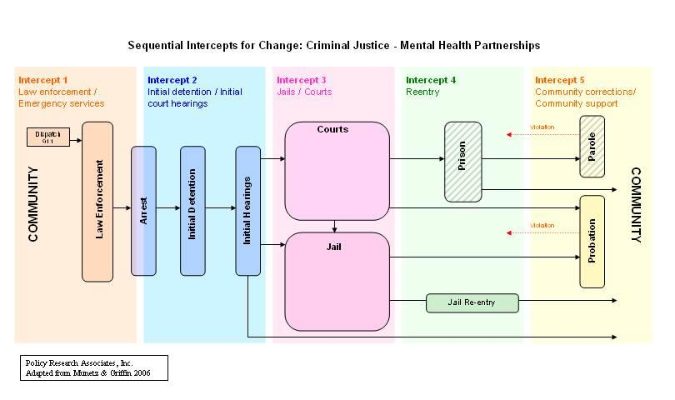
Future Directions for Peer Mentors- Beyond the Court
Notes:
In this pictoral – discuss examples of Peers reaching out to Veterans in jails and development of specialized Veteran Dorms. Also, talk about Peers advocating for community change (i.e., reaching out to communities to support development of courts, and advocating with local leaders and agencies regarding justice-involved issues like access to housing for justice-involved Veterans.

Slide 21
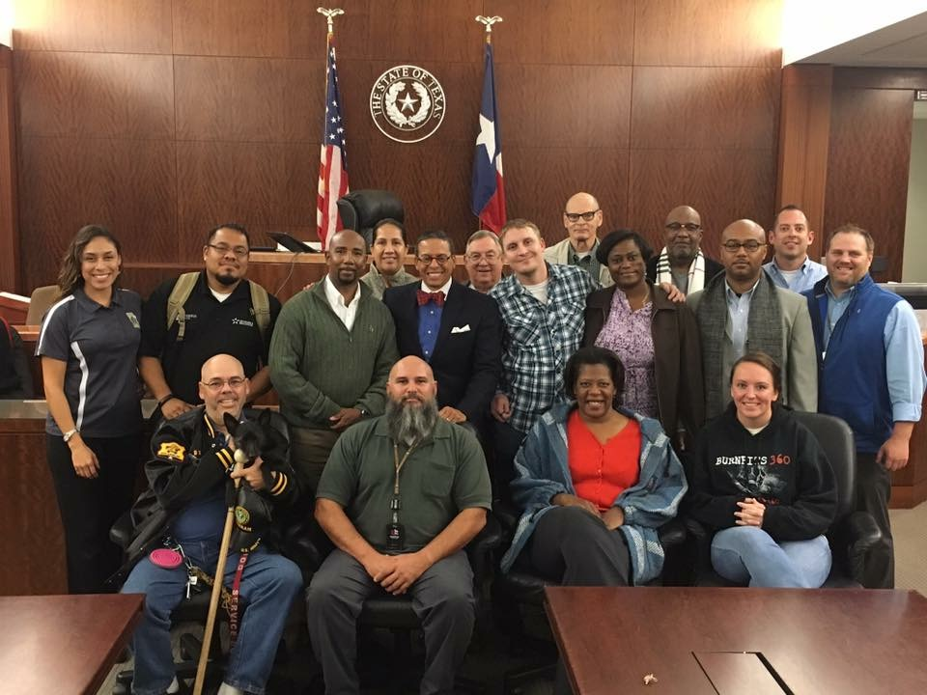
VETERANS TREATMENT COURT
Veterans Treatment Court was created in Texas in 2009 and is a second chance for Veterans entering the criminal justice system. One of the programs that has resulted from the Court is the Veterans Court Advocacy and Mentoring Program (VCAMP). VCAMP is a peer to peer mentoring program of Veterans Serving Veterans, and the results have changed lives. For more information on VCAMP and the Veterans Treatment Courts, visit Mental Health America of Houston

Slide 22
Questions
Your role of the Veteran Mentor is most important!

