Slide 1


Applications of
H.E.A.T. in Forensic Treatment Settings
Enrique Morris | Javier Davila-Lopez, LPC
Jessica Minor, LPC-Associate | Jessica Simmons, LPC, LCDC

Slide 2

IPS Recovery Organization Overview
Outpatient Behavioral Health Provider
Providing behavioral health services to indigent, forensically involved individuals
Dedicated to addressing the underlying causes of addiction & mental health issues with the latest Evidenced Based Practices (EBPs)

Slide 3

Treatment Approach
Collaboration with community partners and court systems
We offer supervised outpatient treatment programs provided by licensed clinicians
Treatment modalities include group, individual, family counseling, and medication assisted treatment
In-person and telehealth treatment options are available

Slide 4
Agenda
IPS’ H.E.A.T. program initiation
Fidelity modifications made by IPS
Explore Cultural Competence vs. Culturally Specific Treatment
H.E.A.T. vs Traditional Approaches
H.E.A.T. Program Development
Explore the H.E.A.T. Structure

Slide 5
What is cultural Competence?
The ability to provide therapy that can overcome cultural barriers that may exist between the therapist and the patient.
Notes:
Cultural competence is an awareness of culture specific values and practices that may influence a patient’s world view and impact how they relate in the therapeutic relationship. Cultural competence is a way to help us under the varying perspective, opinions, and belief systems of those we provide treatment to. A therapist’s ability to be culturally competent allows for the therapist to better understand their patients and adapt treatment to make it relevant to the patient’s needs. This constant awareness allows for the establishment of rapport and trust in the therapeutic relationship. Discuss an example of how this is demonstrated in the therapeutic relationship…

Slide 6
What is culture specific treatment?
The application of culturally sensitive screening and assessment instruments, and therapeutic curriculum.
Notes:
Culture specific treatment is the application of cultural competence. We will explore use of a culturally sensitive curriculum with IPS’ application of the HEAT curriculum.

Slide 7
H.E.A.T. Program Overview
What is H.E.A.T. ?
  Habilitation Empowerment Accountability Therapy
  “…a therapy program designed for minority males, ages 18-29 who are involved in the criminal justice system…H.E.A.T. applies a holistic, culturally relevant and responsive, strength-based model that emphasizes a positive and engaging approach to treatment (Turpin, D. & Wheeler, G., 2013).”

Slide 8
Developers of H.E.A.T.
  Daryl Turpin, MPA (Masters in Public Administration in Human Resource Management), Bachelors of Clinical Social Work, CADC (Certification of Alcohol & Drug Counselor?): Coordinator for Dept Health & Wellness, Chairperson for PAL (Police Activities League) in in Kentucky
  Guy Wheeler, MSW (Masters of Social Work), CAP (Certified Addictions Professional), CCJAP (Certified Criminal Justice Addictions Professional)

Slide 9
H.E.A.T. vs Traditional Interventions
Use of culturally-relevant verbiage
Emphasis of Spirituality Principles
Organized into 3 Categories
No provision of SUD specific psychoeducation

Slide 10
H.E.A.T. Program Initiation at IPS
There is an overrepresentation of minorities who are involved in the criminal judicial system
  Minorities (i.e., Black and Latino) make up approx. 31% of the US population, yet account for 68.6% of incarcerated individuals.
In 2019, IPS was called upon by the Dallas County DA’s office to collaborate and implement a culturally specific treatment intervention for a targeted population of minority males.
H.E.A.T. program initiation at IPS began in February 2020.
Notes:
What were motivating factors that contributed to the HEAT initiative? How did this get on IPS’ radar?
Dallas Co. DA’s office brought it to our attention and requested that we initiate the program about one year prior to initiation.
Percent of Black Americans in the general U.S. population: 13% +
Percent of people in prison or jail who are Black: 38% +; Hispanic 30.6%
Incarceration rate for Black vs white Americans: 2,306 vs. 450 per 100,000 +
Percent of people on probation or parole who are Black: 30% +
Overall % of inmates due to drug offenses 45.3%
Source(s): https://www.prisonpolicy.org/research/race_and_ethnicity/
https://www.bop.gov/about/statistics/statistics_inmate_ethnicity.jsp

Slide 11
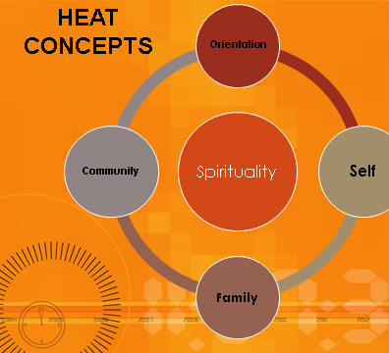
H.E.A.T.
Program Structure

Slide 12
Program Structure: Self
Self: Is a section built around understanding self, core beliefs, attitudes, and thinking errors/patterns.
  Manhood: Speaks directly to understanding of self-view and standard to which we will hold each other accountable while in the program. (core beliefs and expectations)

Slide 13
Program Structure: Self Continued…
  High Cost of Low Living: is teaching cost benefits analysis. Structured in a way that helps the participants understand not just the financial cost of decisions but that there is also a cost to your physical health, family, school/work, legal, and spiritual aspects of life.
  Messed up thinking: “my thinking is just messed up” discusses thinking errors
  Hip Hop: is used as a means of explaining self-expression as well as understanding how outside influences can shape our perceptions.

Slide 14
Program Structure: Family
Family: section in general is also teaching how to be empathetic and see the affect our behavior has on other people.
  Baby Momma Drama: address the topics of co-parenting but initially presents the issues with terms the young men know of more readily.
  Fatherhood: what does it mean to be “present” in a child’s life. “Providing” means more than just financial aid.

Slide 15
Program Structure: Family Continued…
Love or Lust: is about breaking down how one’s own decisions to have sex without fear of consequence or ability to raise a child can affect not just themselves but entire communities. Generations of single parent households have a negative impact on the community they live in.

Slide 16
Program Structure: Community
Community: This section focuses on the importance of advocacy and community involvement. We highlight the impact the community can have on the individual and how the participants can leave a positive impact on their community as well.
  My Hood: Prompts the participants to look deeper into their neighborhoods and see what strengths and opportunities their neighborhood offers as well as the challenges and barriers it may produce.

Slide 17
Program Structure: Community Continued…
Root Causes: Focuses on the where some of the challenges and barriers in the participants’ neighborhoods originate from. The participants will look at the prevailing issues in their communities and either, research an organization that is trying to have a positive impact in that area of concern, or brainstorm solutions that could resolve the problem they have identified.

Slide 18
Program Structure: Community Continued…
Healing Voices: This project serves as a way to teach the participants what it means to be an advocate. The participants will research their chosen topic of concern in their community and ways to resolve it. This includes speaking to city council members, starting a nonprofit, setting up a charity, anything and everything that could be done to support and advocate for their community. The participants will create a presentation and then speak to their community leaders about their topic.

Slide 19
Challenges in
Implementation
Notes:
Is this the same as fidelity modifications?

Slide 20
Challenges Experienced Through Implementation
Implementation according to Evidence Based Practices for Standard IOP vs. H.E.A.T. structure
10 hours of service per week vs. 3 hours
At risk to not complete court program due to “Moderator Variables”
Living in a low-income area
Raised by a single mother
Not completing high school or obtaining a GED
Need to fulfill other court requirements while engaging in an intensive treatment program
Training multiple staff so that Co-facilitation possible
8 hours of orientation prior to group initiation
Intended to be a Closed Group
Referrals trends dependent on external partners
Initiating a new treatment program during COVID-19

Slide 21
Fidelity Modifications

Slide 22
How we adapted H.E.A.T. to align with EBPs…
Program is offered three days per week instead of two.
Sometimes allowing non-minority participants in the group.
Open Group format
During the 3rd day of HEAT each week, Clinician incorporates information from the SSC Curriculum and Seeking Safety Curriculum, and other EBP material to provide psychoeducation on SUD issues.

Slide 23
Successes in Treatment

Slide 24
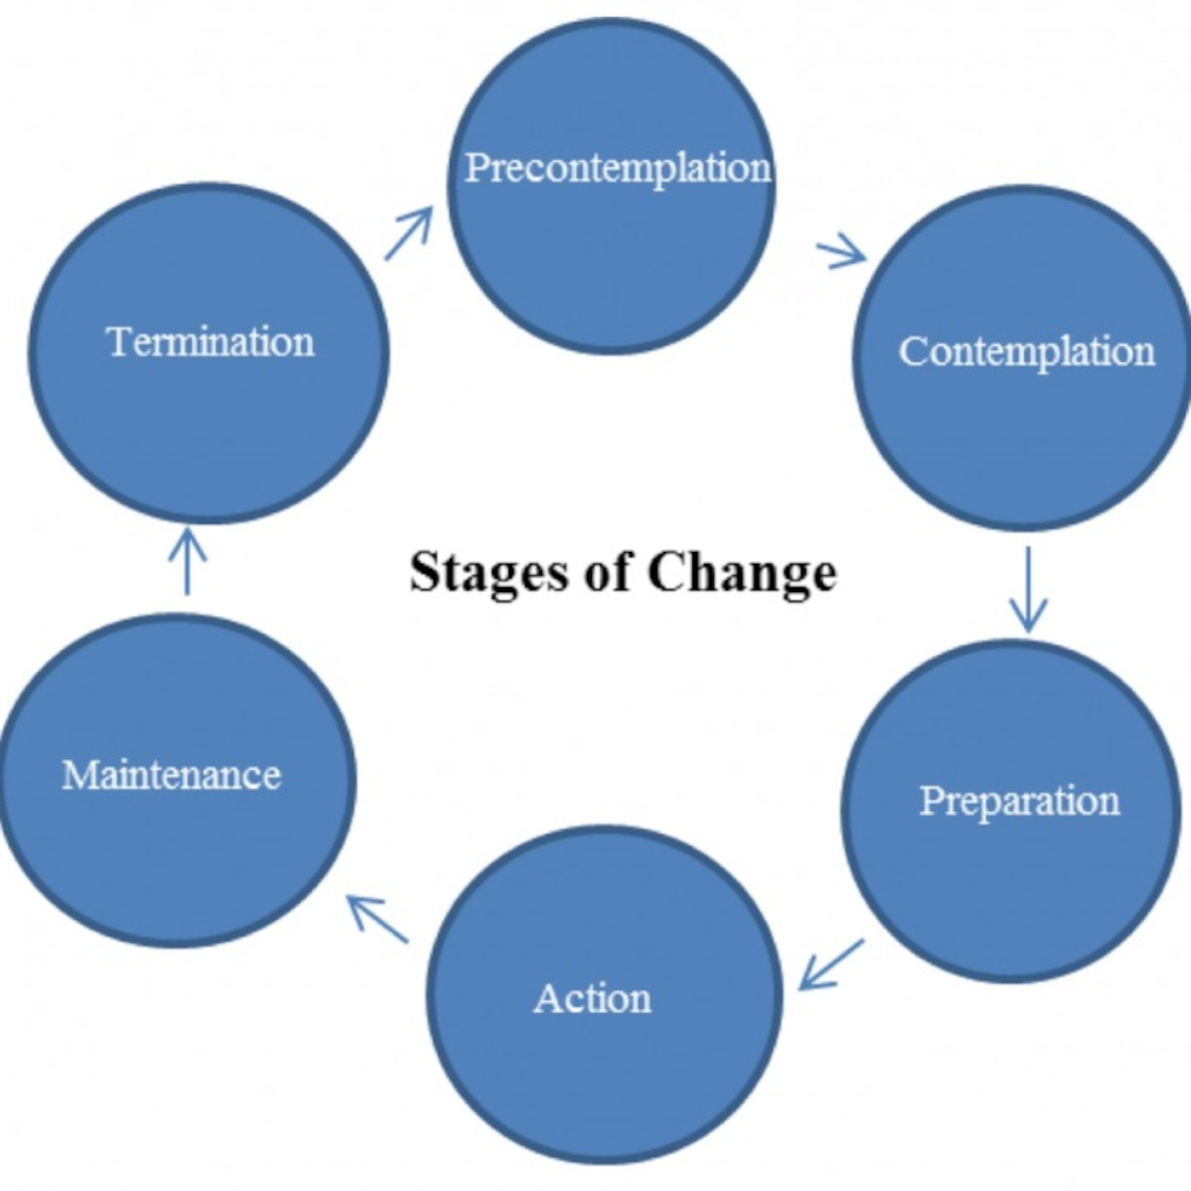
Successes in Treatment
Maintaining engagement with patients leading to higher show rates & lower rate of attrition
  75% overall show rate to groups
  39 total participants served to date
  23 total participants still active
External partners / treatment team member also being trained in HEAT so that messages are reinforced across the Multi-disciplinary Team
Notes:
# of persons served since initiation
# of current active patients

Slide 25
Clinician Observations & Testimonials
Patient Growth and changes while in the program
Patient Reflections:
  “At first I wasn’t messing with this but after a few days I learned that sometimes you need to talk about your problems with people with similar problems to come to peace with them and overcome them.”
  “My experience with the HEAT program has been well. I’ve learned a good amount of thins that will help me be able to change my community and that can help me stay sober.”
  “I learned to open up about my negative thoughts, that I hold in on the inside, and meet great people that go through similar situations.”

Slide 26
Clinician Observations & Testimonials
Patient Reflections:
  “At first I didn’t think I would like it because I didn’t really like my other group a lot but, I like how in this one we can be more communicative and more open.”
  “Heat chilled me out when at first I wasn’t messing with it because I thought it was pointless.”
  “My experience with HEAT has been great, it gives you the opportunity to express yourself, and it allows you to be yourself.”
  “What I like about HEAT is I can actually open up and express how I feel and get great feedback.”
  “My experience with HEAT has been helpful in the sense of seeing others and heating stories and problems. Also, HEAT allowed me to hear advice that I may have not received otherwise.”
  “What I like about heat is that it gives me different ways to deal with a situation, and we can vent about our problems.”
  “HEAT is the best part of the program because I get to talk to someone about the problems I have in my life. Before I would have just to hold them in.”

Slide 27
What are We looking to achieve in the future?

Slide 28
Future Considerations…
  Continue to provide culturally competent curriculum to lower income or under privileged young minority males.
  To increase drug court participation success rate and reduce the recidivism rate of minority men.
  Accurately assess efficacy for HEAT program and other IOP programs.
  H.E.A.T has known possible limitations on of it not being an empirically validated model, & we hope our use of the curriculum can be incorporated into future studies.
  Emphasize that culturally competent curriculum is needed and is EBP. Hopefully aiding in the development of more culturally competent curriculum not just for minority males.
Notes:
Verify Data
Successful Discharges: 43.75% (7 out of 16 patients that have been discharged)
Advanced to the next Phase in Treatment: 64.10% (25 of 39 patients)
Elevations in Care: 23.08% (9 of 39 patients)
Retention rate

Slide 29
Q&A

Slide 30

Thank you!
IPSRecovery.com

